Slide 1
Comparative genomic analysis of esophageal squamous cell carcinoma between Asians and Caucasian patient populations
Lilith Feer, Laura Meulenbroeks, Thanh Elsener

Slide 2
Goal
Compare the genome of Asian and Caucasian patients with ESCC (esophageal squamous cell carcinoma)
Overall goal: Identify race-specific driver mutations
Precision medicine

Slide 3
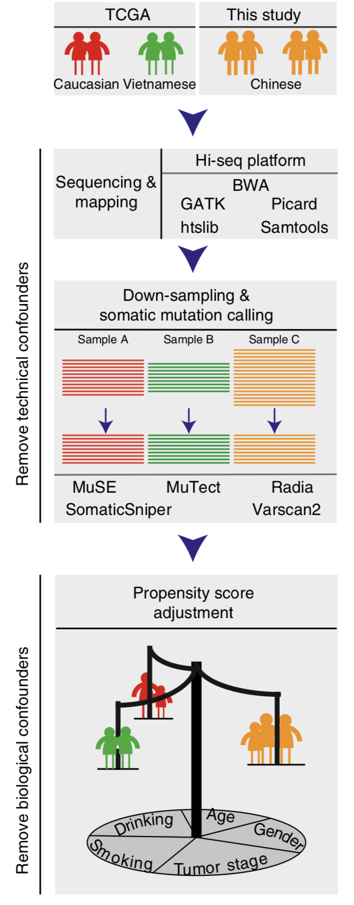
Procedure
WES
Mapping with same pipeline
Down-sampling
Different sequencing depth
Random removal of reads
Remove confounding effects
Technical factors
Biological factors: smoking, drinking, age, gender, tumor stage
Notes:
In this study, they did whole exome sequencing of Chinese patients. In addition, data from whole exome sequencing of Caucasian and Vietnamese patients from TCGA was analyzed. All the data was mapped in the same way
See if Chinese and Vietnamese patients could be seen as one population. For this, they compared the

Slide 4
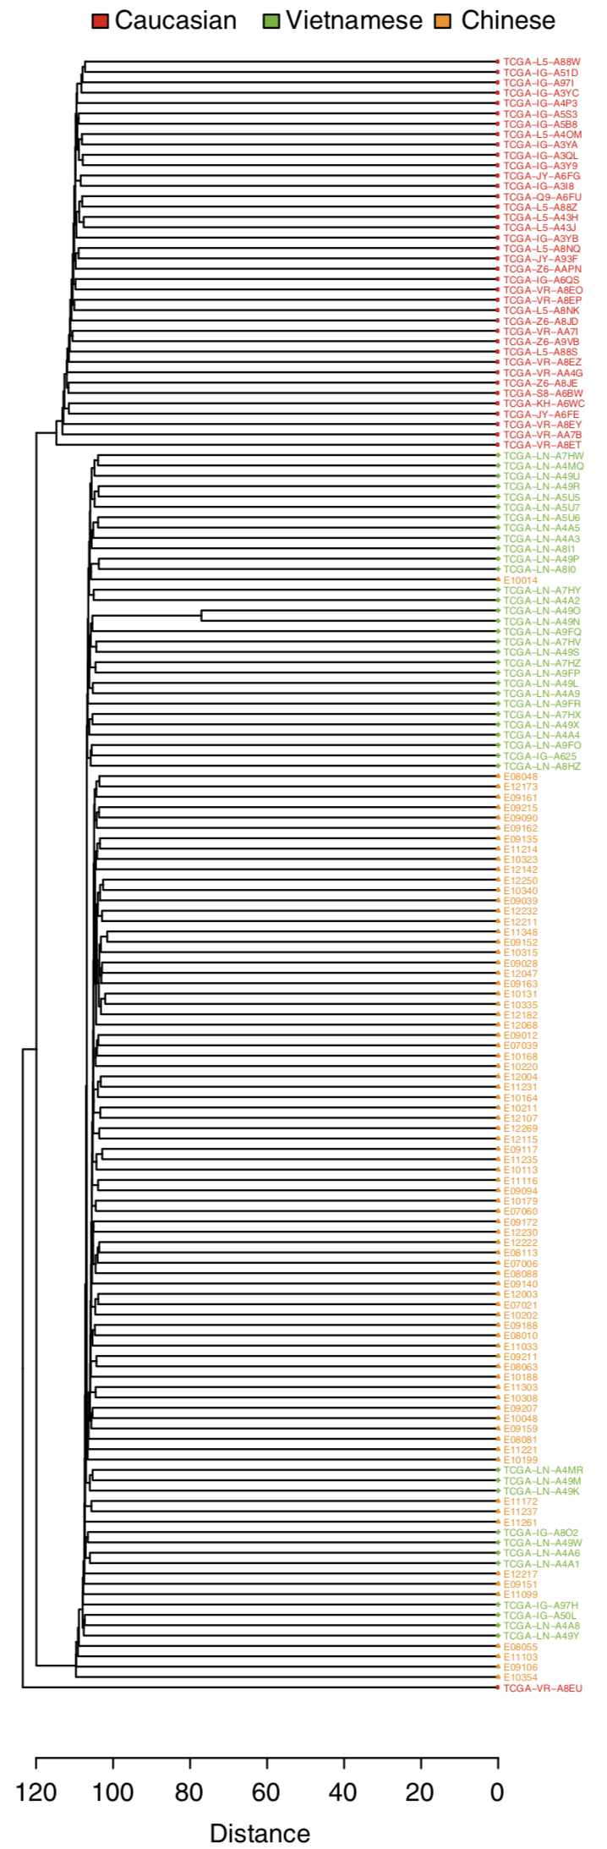
Vietnamese and Chinese → Asian
SNPs
Alcohol metabolizing enzymes (risk factor)
Conclusion
Significantly mutated genes in ESCC (Asian population)
CSMD3 has potential prognostic power in Asian people
TP53, EP300, NFE2L2 are more frequently mutated in Asian patients

Slide 5
Questions?

